Slide 1
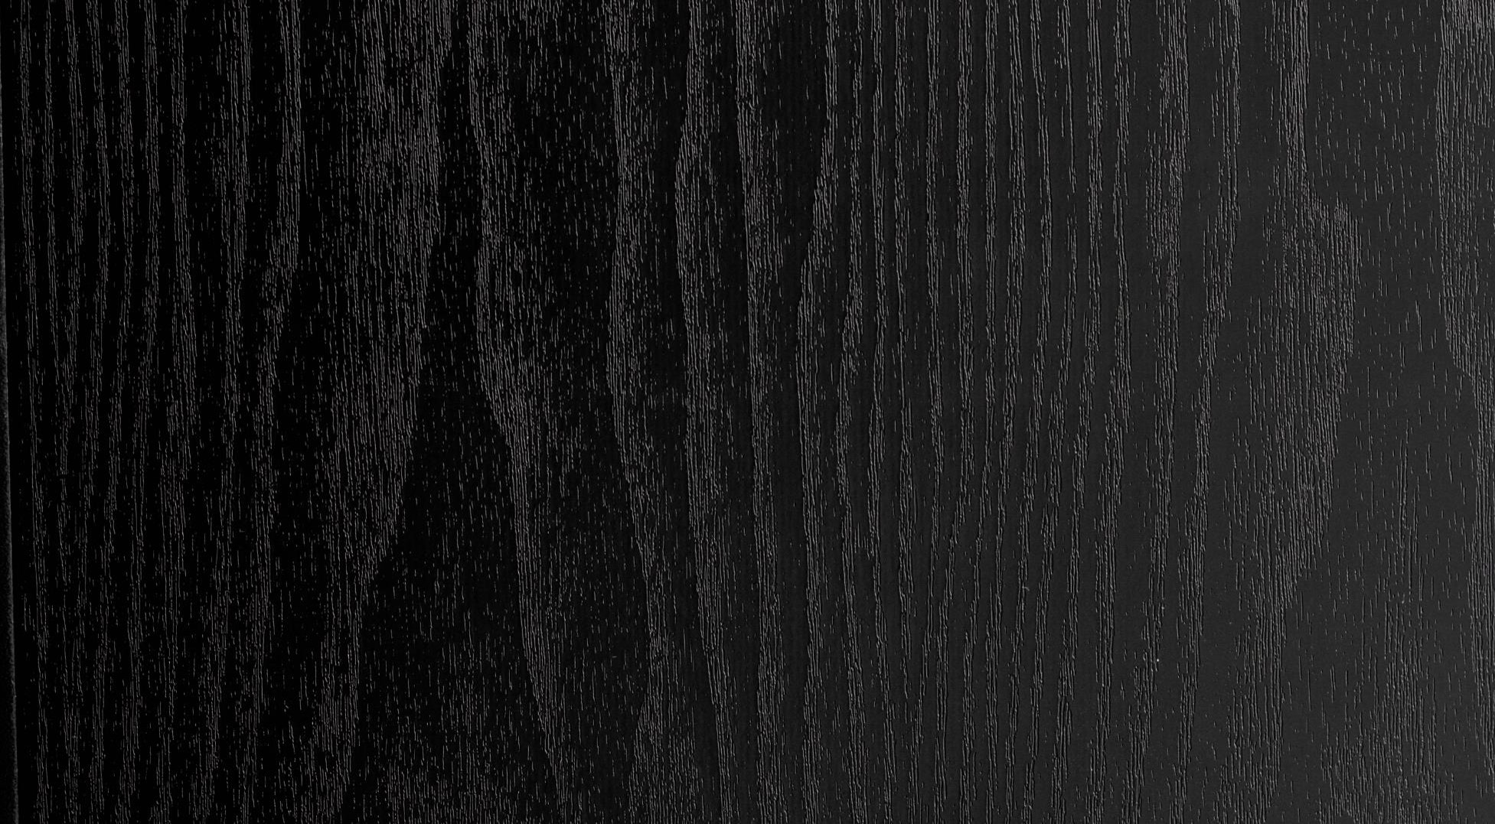
VISUAL TEXT TRANSLATOR

Slide 2
TABLE OF CONTENT
INTRODUCTION:
MOTIVATION
PROBLEM STATEMENT
AIMS AND OBJECTIVES
DATASET:
COMPLILING DATASET
EXAMPLE
DEFINING TEST AND TRAIN DATA SETS
MODEL TRAIN:
MAKS R-CNN
MODEL TEST:
ACCURACY
ACTUAL VS PREDICTED
PREDICTED BOUNDING BOX
ADJUSTING BOUNDING BOX
TEXT REMOVAL
TRANSLATED TEXT
RESULTS

Slide 3
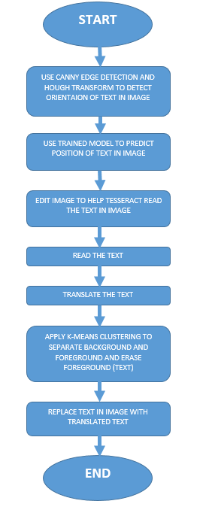
FLOW CHART:

Slide 4
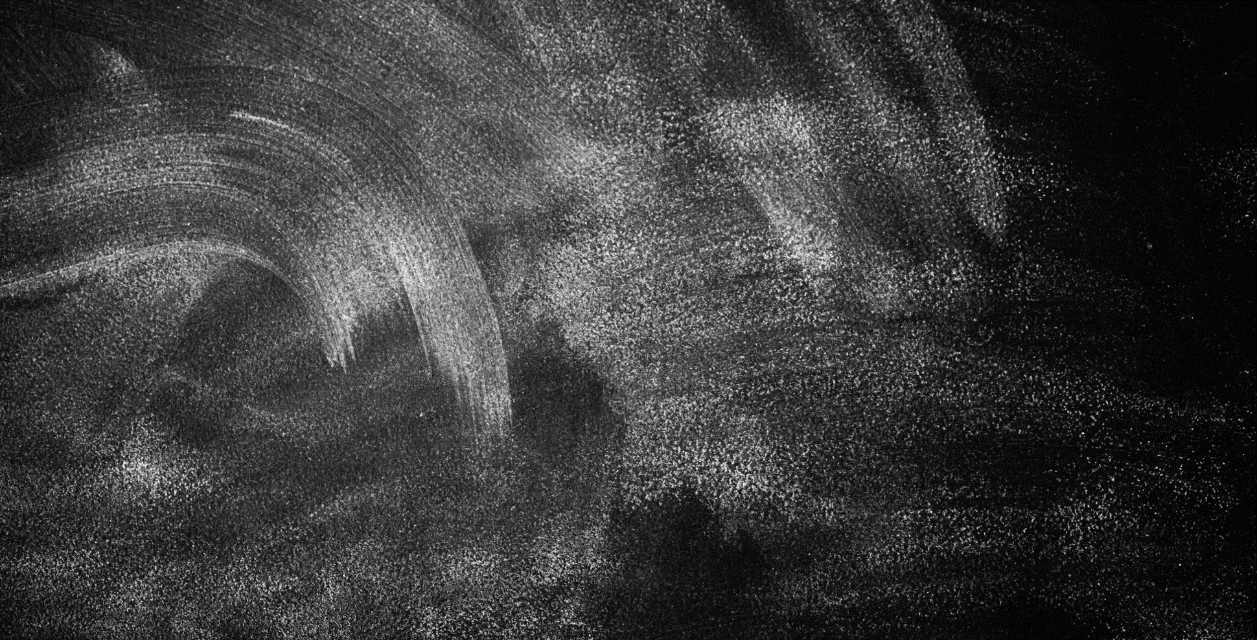
INTRODUCTION

Slide 5
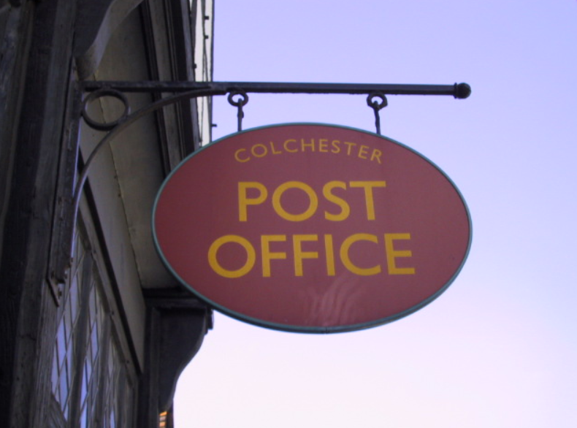
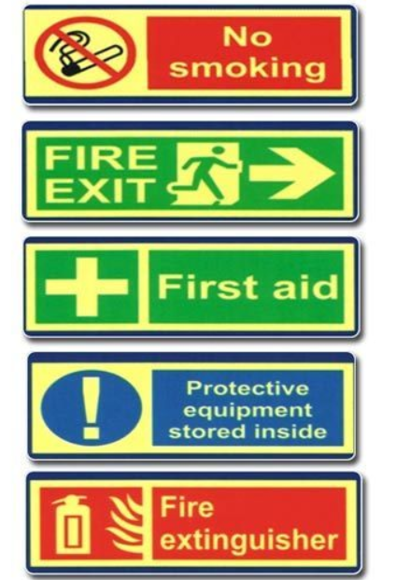
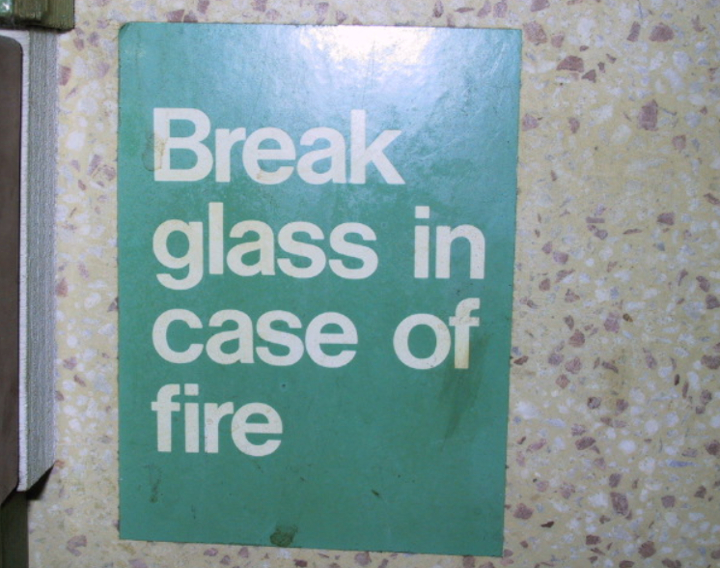

Slide 6
MOTIVATION
WHENEVER A TOURIST WANTS TO SEE THE MEANING OF A WORD HE OFTEN REFERS TO A DICTIONARY WHICH IS A TAB BIT TEDIOUS PROCESS.
THROUGH THIS PROJECT WE WANTED TO ENSURE THAT THE TRANSLATION WAS A CLICK AWAY.
WETHER IT BE AN IMPORTANT SIGN BOARD, A SUBWAY MAP, A BILLBOARD, BANNER OR A SHOP NAME BOARD, WE WANTED THIS PROJECT TO BE ABLE TO TRANSLATE IT ALL.
WE WANT TO GIVE EVERYONE A CHANCE TO TRAVEL WITHOUT THE BURDEN OF NOT KNOWING THE LANGUAGE.

Slide 7
PROBLEMS STATEMENT
TO USE ADVANCE IMAGE PROCESSING, MACHINE LEARNING AND MODELING TECHNIQUES TO OBTAIN A GENERALLY ACCURATELY TRANSLATE THE TEXT IN AN IMAGE.

Slide 8
AIMS AND OBJECTIVE
TO FORM A GENERALLY ACCURATE OCR ALGORTHM.
TO USE MACHINE LEARNING FOR TEXT DETECTION AND LOCALIZATION.
TO IMPLEMENT MANY IMAGE ENHANCEMENT TECHNIQUES TO FINALLY REPLACE ORIGINAL IMAGE TEXT WITH TRANSLATED TEXT.

Slide 9
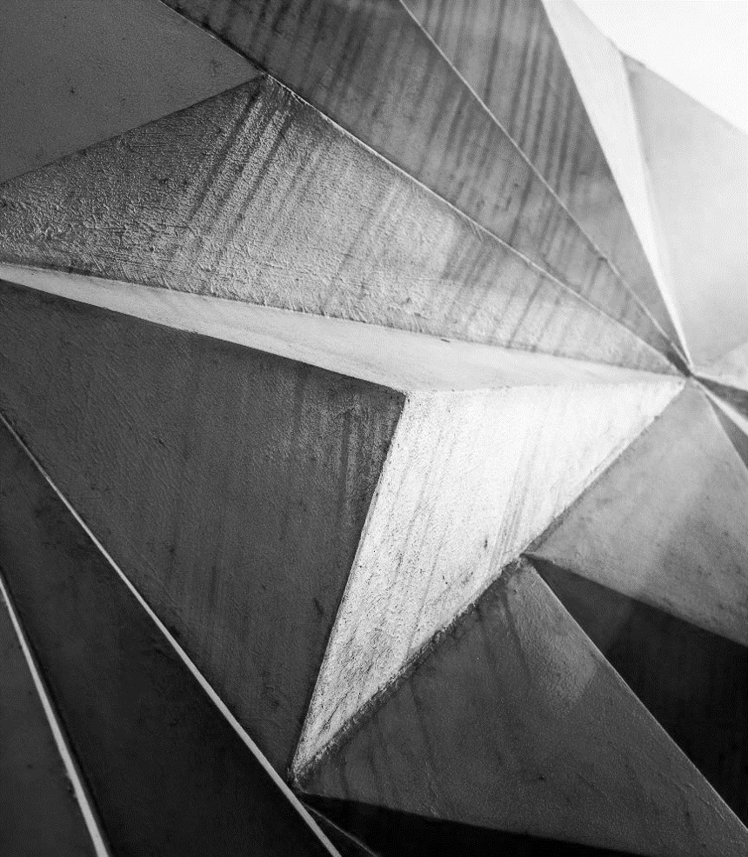
DATASET

Slide 10
COMPILING DATASET:
THE IMAGES WERE OPENED THROUGHT THE MATPLOTLIB AND CV2 LIBARARY
THE COORDINATES FOR THE REGION OF INTEREST WERE THEN EXTRACTED MANUALLY THROU A MOUSE CLICK EVENT.
XMIN AND YMIN WERE EXTRACTED THROUGH ONE CLICK AND XMAX AND YMAX WERE EXTRACTED THROUGH THE SECOND CLICK AND A BOX WAS FORMED TO DETERMINE THE REGION OF INTEREST.
THE COORDINATES WERE WRITTEN TO THE XML FILE USING THE CSV LIBARARY.(FILE HANDLING)

Slide 11
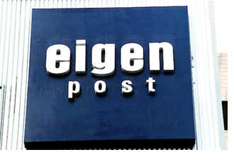
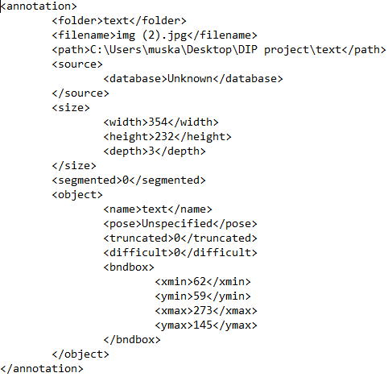
EXAMPLE:

Slide 12
DEFINING TRAIN AND TEST DATASETS
WE MADE A TRAIN DATASET OF UPTO 161 IMAGES.
AND A TEST DATASET OF UPTO 38 IMAGES.
ALL OF THESE DATASETS CONSIST OF AN IMAGE AND THE CORRESPONDING XML FILE OF WHERE THE TEXT IS LOCATED.

Slide 13
MODEL TRAIN

Slide 14
MASK R-CNN
Mask R-CNN follows a general algorithm to obtain a bounding box on the required region or object. The steps it follows are:
It uses a Convolutional Neural Network (CNN) as the backbone model comprising of multiple layers selected by Mask R-CNN itself to efficiently extract the features wanted. Conv2D will turn a 1024x1024x3 image into a 32x32x2048 feature map that will in serve as input for the next layer.
Next Region Proposal Network (RPN) is used to make regions that are defined by as many as 200k anchor boxes and then scan each region in the feature map to detect which region contains the wanted object (i.e text).

Slide 15
MASK R-CNN
The algorithm then takes these regions (with the text) as input and outputs the class in which it belongs (Classification) and the bounding box.
The Regions of Interests (ROI) are then taken as inputs and 28x28 pixel masks are generated for each object. These masks are then scaled up during inference.

Slide 16
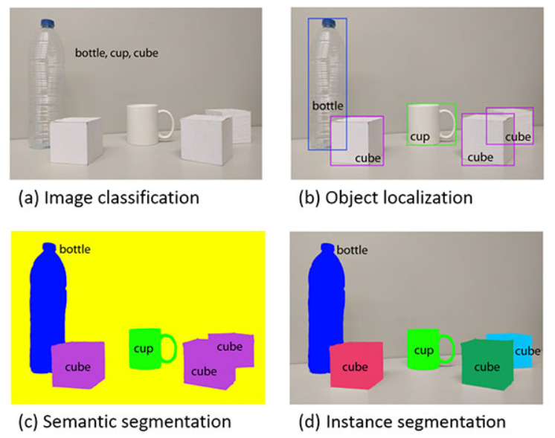
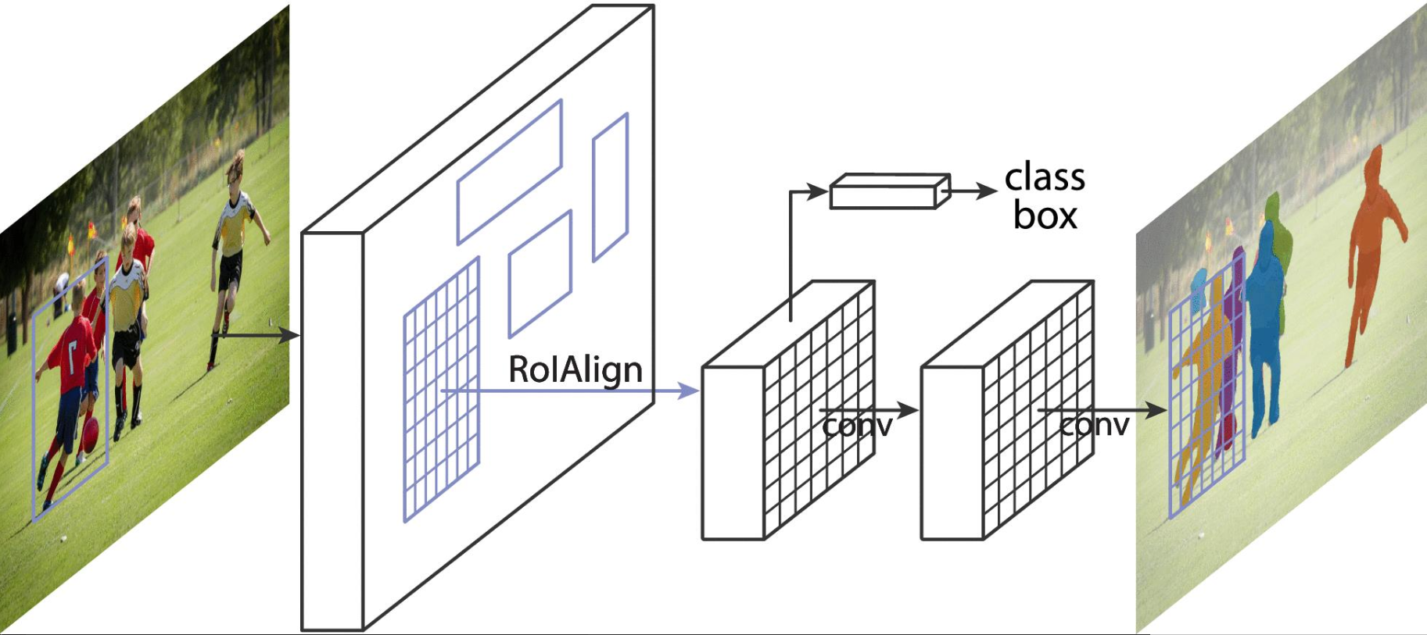

Slide 17
MODEL TEST

Slide 18
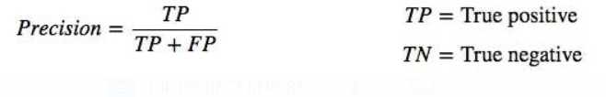
ACCURACY
ACTUAL VS PREDECTED
mAP

Slide 19
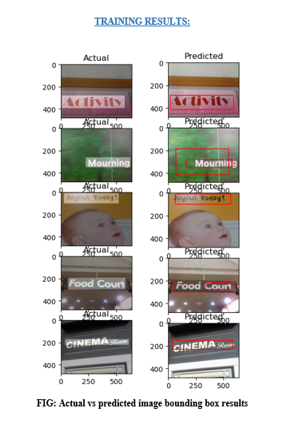
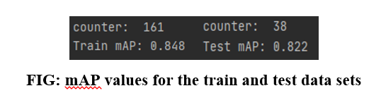
ACTUAL VS PREDICTED:

Slide 20
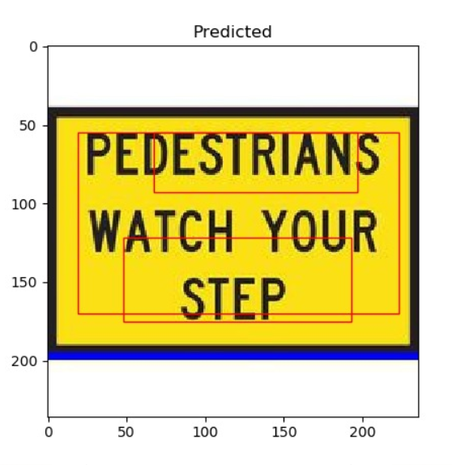
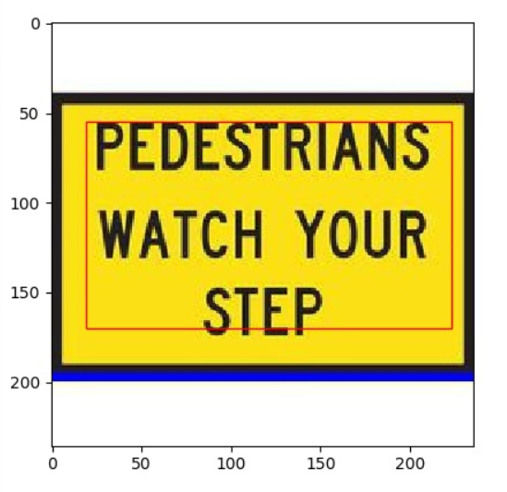
PREDICTED BOUNDED BOX:
A NUMBER OF BOUNDING BOX ARE DRAWN. THE BOX WITH THE HIGHEST CONFIDENCE SCORE WILL BE SELECTED AS SHOWN IN THE SECOND IMAGE.

Slide 21
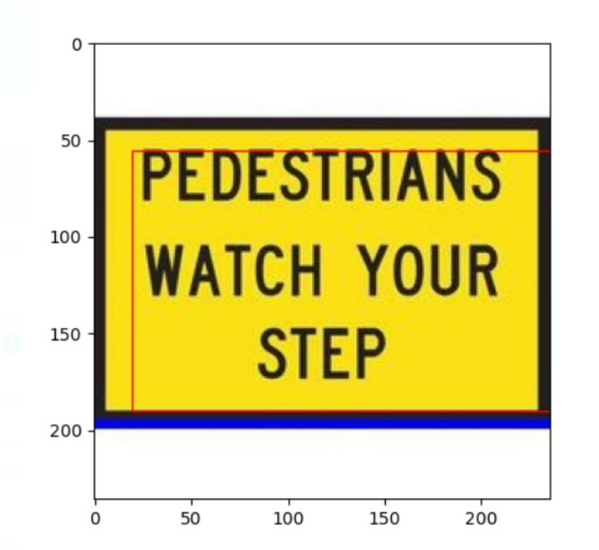
ADJUSTED BOUNDING BOX:
WE HAVE EXTENED THE BOUNDING BOX IN ORDER FOR THE BETTER DETECTION OF TEXT IN THE IMAGE.

Slide 22
TEXT REMOVAL

Slide 23
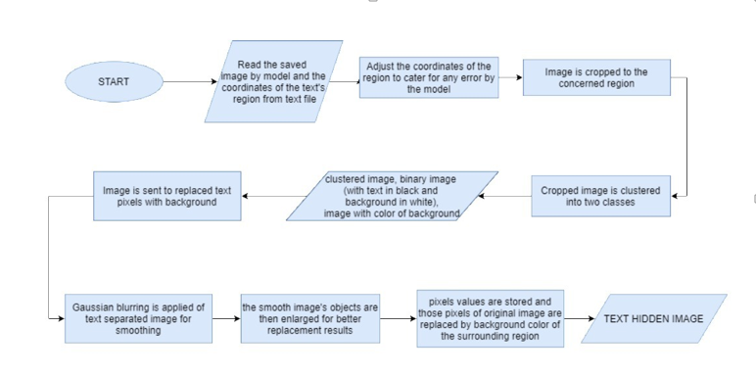
FLOW CHART

Slide 24
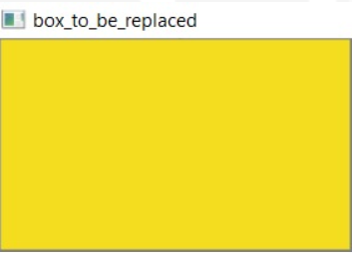
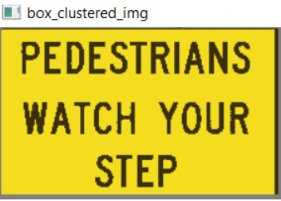
REMOVING TEXT FROM THE IMAGE:

Slide 25
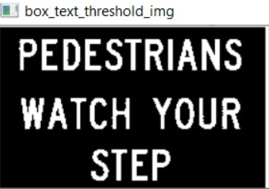
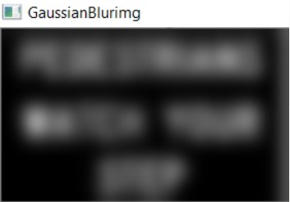
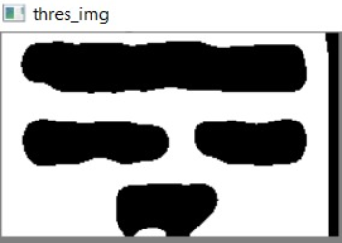
REMOVING TEXT FROM THE IMAGE:

Slide 26
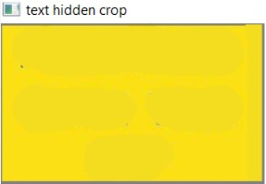
FINAL OUTPUT:

Slide 27
TRANSLATED TEXT

Slide 28
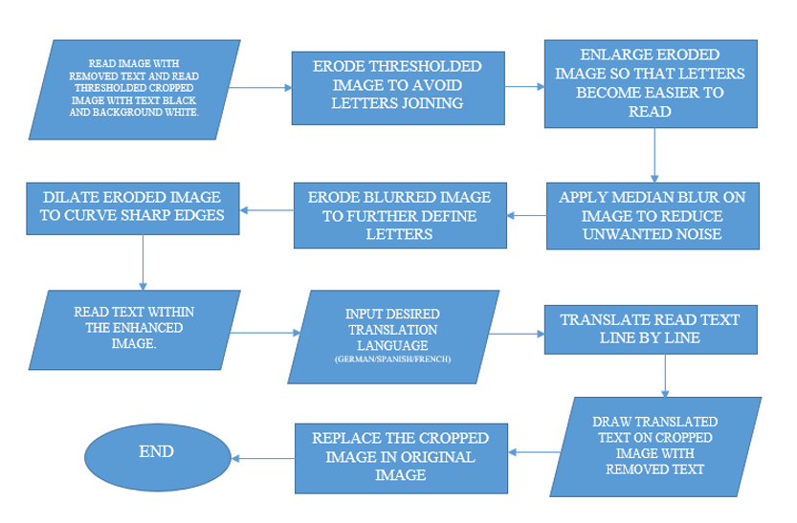
FLOW CHART:

Slide 29
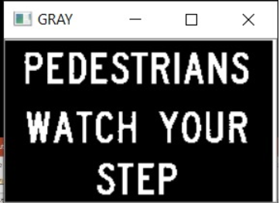
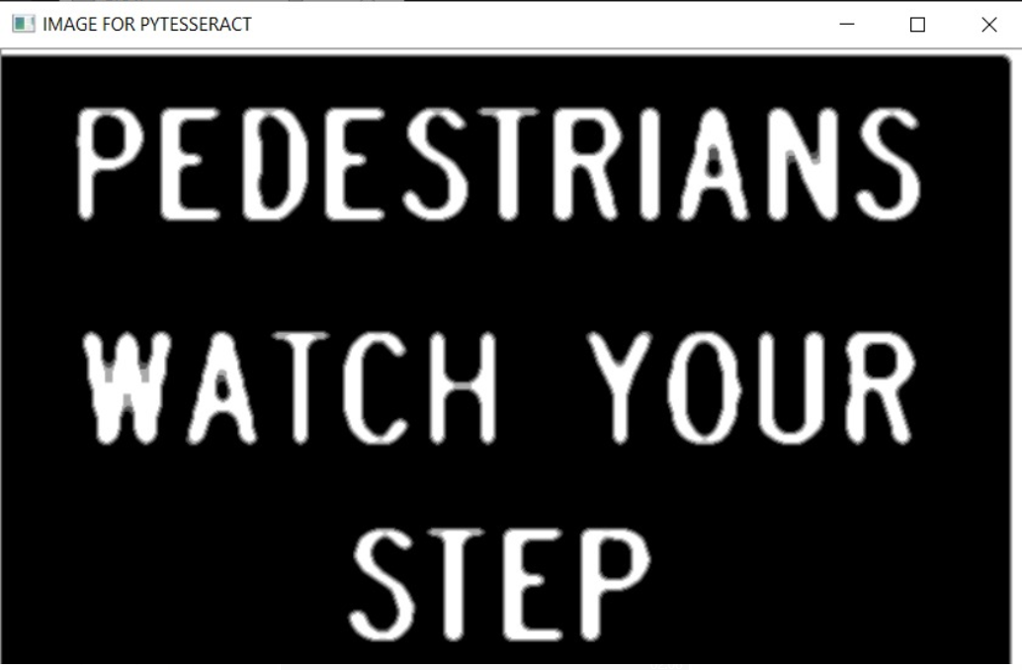
TRANSLATED TEXT

Slide 30
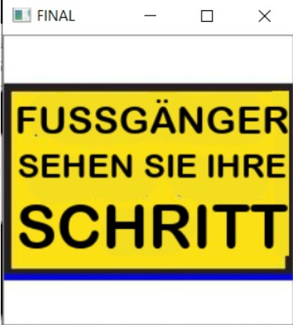
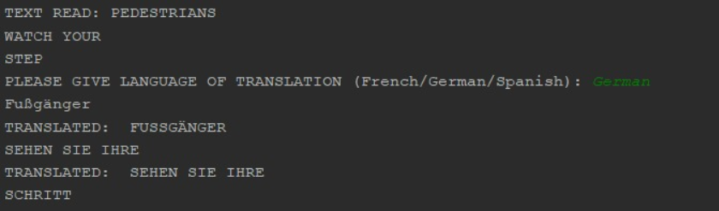
FINAL OUTPUT:

Slide 31
RESULTS

Slide 32
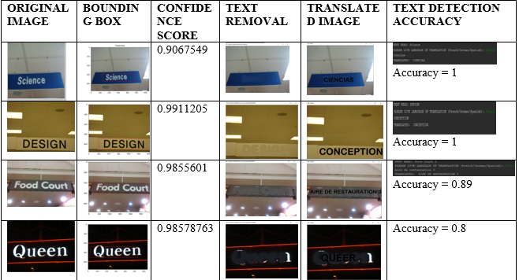

Slide 33
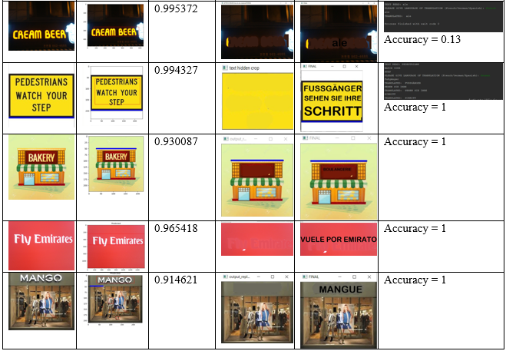

Slide 34
THANK YOU

